Slide 1

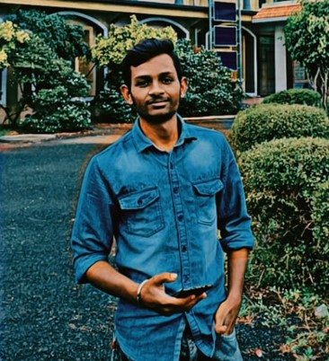

Driver Drowsiness Detection System with OpenCV & Keras
Add Your Professional Profile Photo Here
Program Feedback
Project Short Summary
The Driver Drowsiness Detection System combines computer vision and deep learning to enhance road safety. It monitors a driver’s eyes in real-time, alerting them when signs of drowsiness are detected. The project’s strengths include real-time monitoring, eye tracking using OpenCV, and a deep learning model for drowsiness classification. Suggestions for improvement include addressing false positives and integrating the system with vehicle alarms.
Great job on the project!
The Driver Drowsiness Detection System combines computer vision and deep learning to enhance road safety. It monitors a driver’s eyes in real-time, alerting them when signs of drowsiness are detected. The project’s strengths include real-time monitoring, eye tracking using OpenCV, and a deep learning model for drowsiness classification. Suggestions for improvement include addressing false positives and integrating the system with vehicle alarms.
Battula Chakradhar
battulachakradhars@gmail.com
Krishna Chaitanya Institute of Technology & Sciences,markapur
#skillsbuild

Slide 2
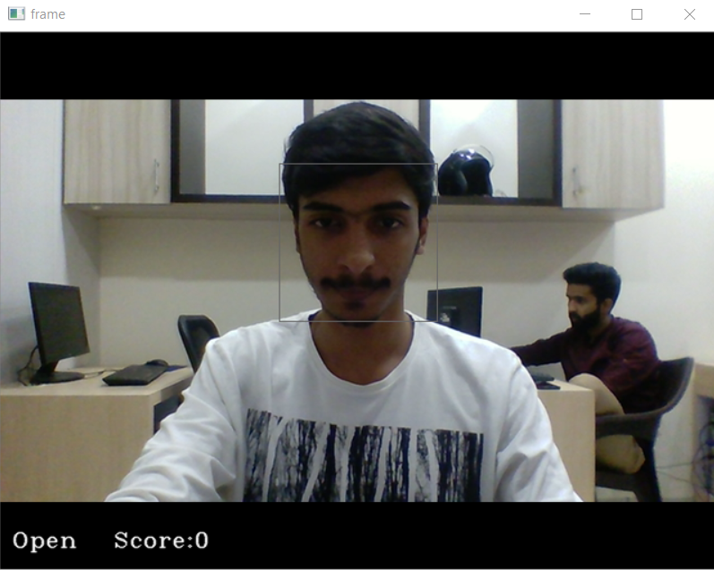
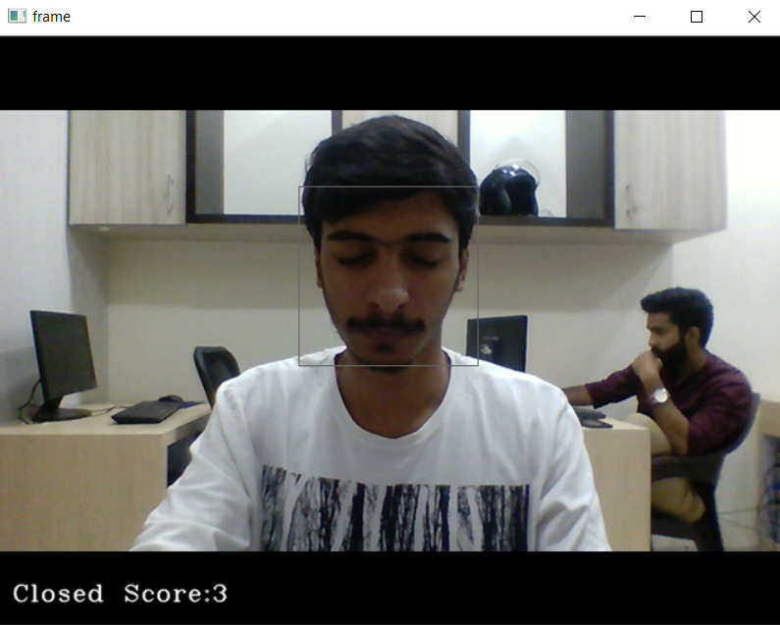
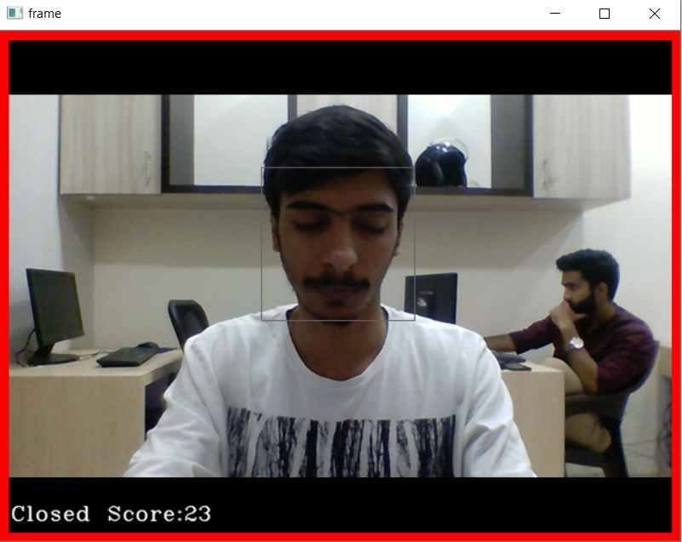
Final project Outcome Screanshort

